Slide 1

Software Development Life Cycle (SDLC)
Software Processes

Slide 2
Software Processes
Coherent (Relational) sets of activities for specifying, designing, implementing and testing software systems

Slide 3
Objectives
To introduce software process models
To describe a number of different process models and when they may be used
To describe outline process models for requirements engineering, software development, testing and evolution
To introduce CASE technology to support software process activities
Note: CASE (Computer-Aided Software Engineering)

Slide 4
The software process
A structured set of activities required to develop a
software system
  Specification
  Design
  Validation
  Evolution
A software process model is an abstract representation of a process. It presents a description of a process from some particular perspective

Slide 5
Generic software process models
Generic software process models are frameworks that outline the steps needed to design, develop, test, and deliver software. They include activities like communication, planning, modeling, construction, and deployment
The waterfall model
  Separate and distinct phases of specification and development
Evolutionary development
  Specification and development are interleaved
Formal systems development
  A mathematical system model is formally transformed to an implementation (relation algebra in dbms, Data Structure )
Reuse-based development
  The system is assembled from existing components

Slide 6
Waterfall model

Slide 7
Waterfall model phases
Requirements analysis and definition
System and software design
Implementation and unit testing
Integration and system testing
Operation and maintenance
The drawback of the waterfall model is the difficulty of accommodating change after the process is underway

Slide 8
Waterfall model problems
Inflexible partitioning of the project into distinct stages
This makes it difficult to respond to changing customer requirements
Therefore, this model is only appropriate when the requirements are well-understood

Slide 9
Evolutionary development
Exploratory development
  Objective is to work with customers and to evolve a final system from an initial outline specification. Should start with well-understood requirements
Throw-away prototyping (Throwaway prototyping is a way of making a fast and cost-effective model of app user interface and its features)
  Objective is to understand the system requirements. Should start with poorly understood requirements
  Deliver the system in different and improve versions

Slide 10
Evolutionary development
Problems
  Lack of process visibility
  Systems are often poorly structured
  Special skills (e.g. in languages for rapid prototyping) may be required
Applicability
  For small or medium-size interactive systems
  For parts of large systems (e.g. the user interface)
  For short-lifetime systems

Slide 11
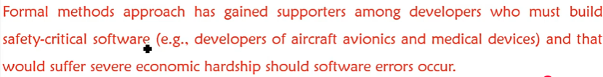
Formal systems development
Based on the transformation of a mathematical specification using mathematical notation through different representations to an executable program
Transformations are ‘correctness-preserving’ so it is straightforward to show that the program conforms to its specification
Embodied in the ‘Cleanroom’ approach to software development

Slide 12
Formal transformations

Slide 13
Formal systems development
Problems
  Need for specialised skills and training to apply the technique
  Difficult to formally specify some aspects of the system such as the user interface
Applicability
  Critical systems especially those where a safety or security case must be made before the system is put into operation

Slide 14
Reuse-oriented development
Based on systematic reuse where systems are integrated from existing components or COTS systems (Commercial-off-the-shelf , software refers readily available for purchase and use without modification)
Process stages
  Component analysis
  Requirements modification
  System design with reuse
  Development and integration
This approach is becoming more important but still limited experience with it

Slide 15
Reuse-oriented development

Slide 16
Process iteration
System requirements always evolve in the course of a project so process iteration where earlier stages are reworked is always part of the process for large systems
Iteration can be applied to any of the generic process models
Two (related) approaches
  Incremental development
  Spiral development

Slide 17
Incremental development
Rather than deliver the system as a single delivery, the development and delivery is broken down into increments with each increment delivering part of the required functionality
User requirements are prioritised and the highest priority requirements are included in early increments
Once the development of an increment is started, the requirements are frozen however requirements for later increments can continue to evolve

Slide 18
Incremental development advantages
Customer value can be delivered with each increment so system functionality is available earlier
Early increments act as a prototype to help produce requirements for later increments
Lower risk of overall project failure
The highest priority system services tend to receive the most testing

Slide 19
Extreme programming
New approach to development based on the development and delivery of very small increments of functionality.
Extreme Programming (XP) is an Agile software development methodology that focuses on delivering high-quality software through frequent and continuous feedback.
Relies on constant code improvement, user involvement in the development team and pairwise programming

Slide 20
Spiral Development
Process is represented as a spiral rather than as a sequence of activities with backtracking
Each loop in the spiral represents a phase in the process.
No fixed phases such as specification or design - loops in the spiral are chosen depending on what is required
Risks are explicitly assessed and resolved throughout the process.
Risk analysis involves evaluating technical, schedule, cost risks, market risk and value risk
Objective and alternate
solutions

Slide 21
Spiral model sectors
Objective setting
  Specific objectives for the phase are identified
Risk assessment and reduction
  Risks are assessed and activities put in place to reduce the key risks
Development and validation
  A development model for the system is chosen which can be any of the generic models
Planning
  The project is reviewed and the next phase of the spiral is planned

Slide 22
Software specification
The process of establishing what services are required and the constraints on the system’s operation and development
Requirements engineering process
  Feasibility study
  Requirements elicitation (Draw) and analysis
  Requirements specification
  Requirements validation
  Requirement Document

Slide 23
The requirements engineering process

Slide 24
Software design and implementation
The process of converting the system specification into an executable system
Software design
  Design a software structure that realises the specification
Implementation
  Translate this structure into an executable program
The activities of design and implementation are closely related and may be inter-leaved

Slide 25
Design process activities
Architectural design
Abstract specification
Interface design
Component design
Data structure design
Algorithm design

Slide 26
The software design process

Slide 27
Design methods
Systematic approaches to developing a software design
The design is usually documented as a set of graphical models
Possible models
  Data-flow model
  Entity-relation-attribute model
  Structural model (Display the organization of a system in terms of the components that make up that system and their relationships. )
  Object models

Slide 28
Programming and debugging
Translating a design into a program and removing errors from that program
Programming is a personal activity - there is no generic programming process
Programmers carry out some program testing to discover faults in the program and remove these faults in the debugging process

Slide 29
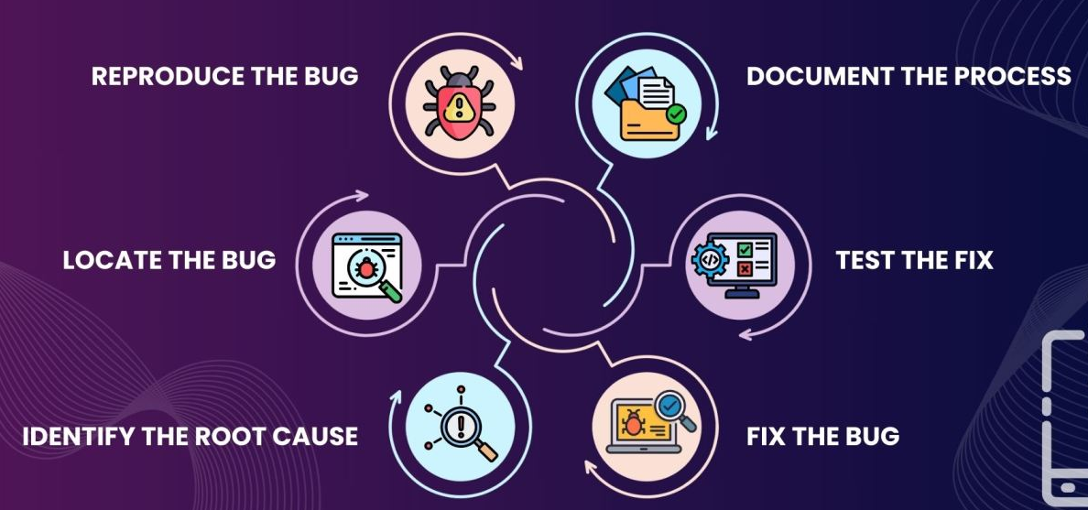
The debugging process
The debugging process involves finding and fixing errors or bugs in software.
It typically includes reproducing the bug, locating it, identifying the root cause, fixing it, testing the fix, and documenting the process.

Slide 30
Software validation
Verification and validation is intended to show that a system conforms to its specification and meets the requirements of the system customer
Involves checking and review processes and system testing
System testing involves executing the system with test cases that are derived from the specification of the real data to be processed by the system

Slide 31
Testing stages
Unit testing
  Individual components are tested
Module testing
  Related collections of dependent components are tested
Sub-system testing
  Modules are integrated into sub-systems and tested. The focus here should be on interface testing
System testing
  Testing of the system as a whole. Testing of emergent properties
Acceptance testing
  Testing with customer data to check that it is acceptable

Slide 32
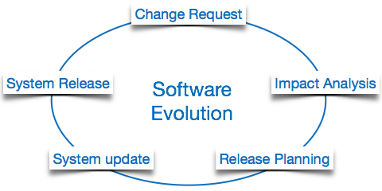
Software evolution
Software is inherently flexible and can change.
As requirements change through changing business circumstances, the software that supports the business must also evolve and change
Although there has been a difference between development and evolution .

Slide 33
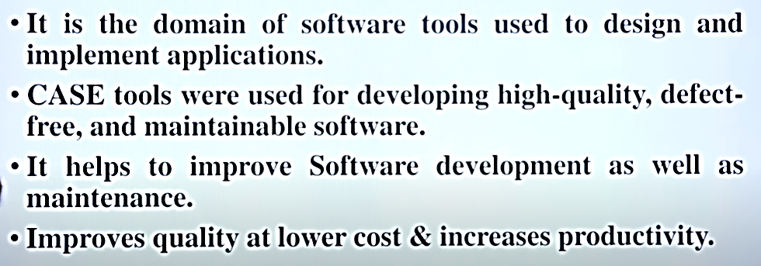
Automated process support (CASE)
Computer-aided software engineering (CASE) is software to support software development and evolution processes

Slide 34
Automated process support (CASE)
Activity automation
  Graphical editors for system model development
  Data dictionary to manage design entities
  Graphical UI builder for user interface construction
  Debuggers to support program fault finding
  Automated translators to generate new versions of a program

Slide 35
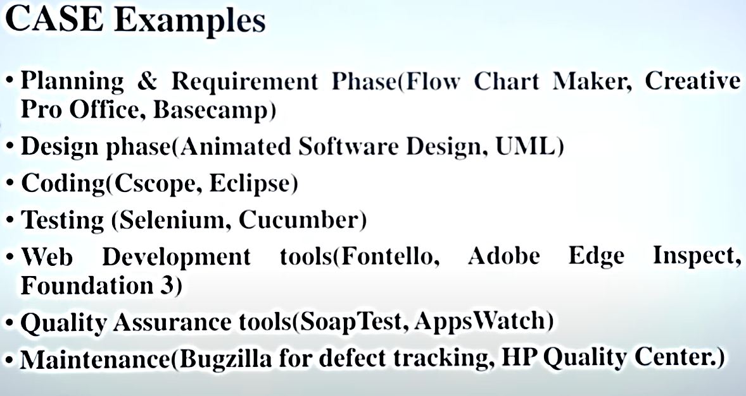
Automated process support (CASE)

